Slide 1
Lesson objective
PBiS Focus
Respect – listening
Empathy – allow others to work
Title: Distance and time graphs
Aim:
Use a distance-time graph to solve related problems
Plan:
- Interpreting line graphs

Slide 2
A distance-time graph plots the distance an object travels against
the time it takes it to travel.
Notes:
Clipart for the car used: http://www.clker.com/clipart-red-car-top-view-8.html

Slide 3
A distance-time graph plots the distance an object travels against
the time it takes it to travel.
The following distance-time graph shows a car’s journey.
What is the total distance the car travelled?
After 4 seconds how far had the car travelled?
After 6 seconds how far had the car travelled?
What happened between 4 and 6 seconds?
220
200
180
160
140
120
Distance along road (metres)
100
80
60
40
20
0
0
1
2
3
4
5
6
7
8
9
10
Time (seconds)
Notes:
Animation inspired by GeoGebra Traffic!

Slide 4
Ex2
The graph shows a cyclist’s journey, from home, to a café and back.
40
Solution
How long was the cyclist’s journey in total?
When did the cyclist have a break and for how long?
Which part was quicker, to the café or back home? How can you tell?
30
Distance from home (miles)
20
10
0
0
1
2
3
4
5
6
7
Time (hours)

Slide 5
Q2
Callum cycles from his home to the supermarket and back.
The following distance-time graph describes his journey.
1 square is 5 minutes
Solution
What is the total distance Callum travelled?
After 15 minutes how far had he travelled?
After 45 minutes how far had the he travelled?
What happened between 12:15 and 12:45?
5
4
3
Distance from home (miles)
2
1
0
11:30
12:00
12:30
13:00
13:30
Time

Slide 6
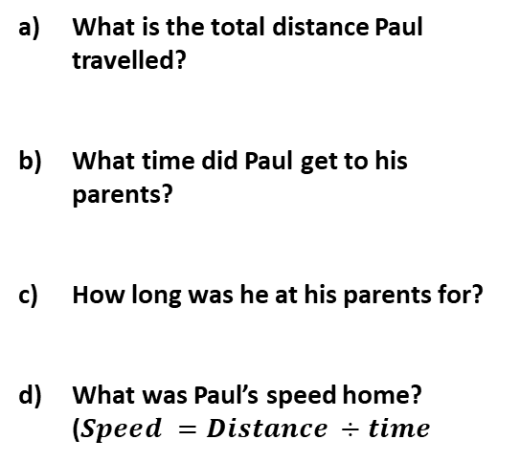
Q3
Paul travels to his parents’ house and then returns home.
The distance-time graph shows information about Paul’s journey.
Solution
What is the total distance Paul travelled?
What time did Paul get to his parents?
How long was he at his parents for?
What was Paul’s speed home? ($Speed =Distance ÷time$
8
6
4
Distance from home (miles)
2
0
12:30
13:30
14:30
Time

Slide 7
A remote control car travels in a straight line.
The following graph describes its distance travelled over time.
Q4
Solution
What is the total distance the car travelled?
After 4 seconds how far had the car travelled?
What happened did the car do between 10 and 12 seconds?
Was the car ever stopped?
20
16
12
Distance travelled (metres)
8
4
0
0
5
10
15
Time (seconds)

Slide 8
Q5
Five distance-time graphs are shown.
Each box below describes one graph.
Write the letter of the correct graph next to its description.
Distance
from
home
Graph C
Solution
Distance
from
home
Graph A
1 | Khalid walked home slowly from his friend’s house.
2 | Natalie walked steadily to the park.
Time
Distance
from
home
Graph E
Time
3 | Sophie walked to school, stopped to look at her watch, realised she was late and then started running.
5 | Michael went out with his friends, realised he had left his wallet at home. He ran home to get it and then ran again to catch up with his friends.
Graph B
Distance
from
home
Graph D
Time
Distance
from
home
4 | David walked to his local gym. Stayed there for a workout and then ran home.
Time
Time
Notes:
Question inspired by CorbettMaths!

Slide 9
1 square is 15 minutes
Ex3
The graph shows part of Matthew’s journey to the gym and back.
12
Solution
10
What long did it take for Mathew to get to the gym?
How long was Mathew at the gym?
Describe what happened at 1 hour and 15 minutes.
How far did Mathew travel in total?
8
Distance from home (km)
6
4
2
0
0
1
2
3
Time (hours)

Slide 10
Individual practice
“what’s green and eats porridge?” 106
“why is an island like a “T”? 67

